Slide 1

UNIVERSITY INSTITUTE OF ENGINEERING
ACADEMIC UNIT 1 & 4
Bachelor of Engineering (Computer Science & Engineering)
Subject Name.-QUANTUM AND SEMICONDUCTOR PHYSICS
Subject Code-20SPT-181
Ms. Arminder
MILLER INDICES
DISCOVER . LEARN . EMPOWER

Slide 2
COURSE OBJECTIVES
The course is designed to make the students industry ready to contribute in the growing demand of the industry at local, national and international level.
It will make the students competent to understand basic concepts and applications of advanced engineering physics and apply its principles in their respective fields at global platform.
It will enhance the skill level of the students and shall make them preferred choice for getting employment in industry and research labs.
It will give thorough knowledge of the discipline to enable students to disseminate knowledge in pursuing excellence in academic areas.

Slide 3
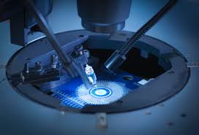
Course Outcomes
CO Number | Title On completion of this course, the students are expected to learn | Level
CO1 | The basic concepts of crystallography and apply its principles in determination of various crystal structures. | Understand Applying
CO2 | The basic concepts of semiconductor physics, illustrate the working of various semiconductor components and use its principles in design of devices and its applications. | Understand Applying Analyze Design
CO3 | The working principle of various lasers, identify its components and justify their importance and applications in different fields of technology. | Understand Applying Analyze
CO4 | The working principle of optical fibre, predict the various losses and recommend its wide applications mainly in communication. | Understand Applying Analyze
CO5 | The basic concepts of quantum mechanics, use its principles in solving quantum mechanical problems and recommend its applications in quantum computing and nanotechnology. | Understand Applying
Figure 2.1 Manufacturing of semiconductor [1]

Slide 4
INTRODUCTION
UNIT -1
BASICS OF SEMICONDUCTOR PHYSICS
CHAPTER 1
CRYSTALLOGRAPHY
MILLER INDICES, D-SPACING, ATOMIC PACKING FRACTION

Slide 5
LECTURE OBJECTIVE
1
Student will learn how to measure miller indices.
2
Students will get to know about d- spacing.
3
Students will understand about APF and how to calculate it.

Slide 6
CONTENT
MILLER INDICES-
INTRODUCTION
METHOD
NOTATION
D SPACING-
DERIVATION
ATOMIC FRACTION
FCC, SC, BCC, FCC and HCP structures

Slide 7
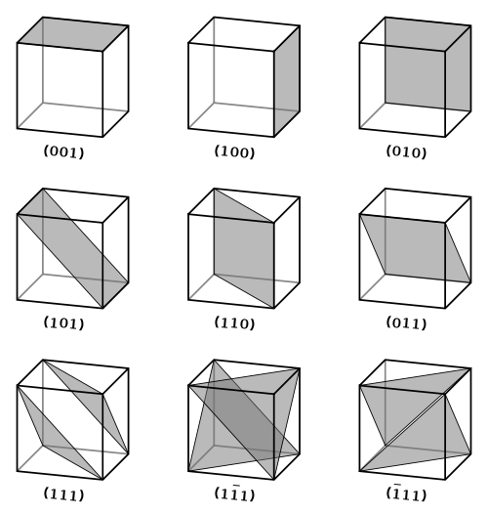
MILLER INDICES
Definition
Miller indices are used to specify directions and planes.
The number of indices will match with the dimension of the lattice or the crystal.
E.g. in 1D there will be 1 index and 2D there will be two indices etc.
Figure 2.2 different planes in crystal [2]

Slide 8
HOW TO FIND-METHOD
Determine the intercepts of the face along the crystallographic axes, in terms of unit cell dimensions.
Take the reciprocals
Clear fractions
Reduce to lowest terms
For example, if the x-, y-, and z- intercepts are 2, 1, and 3, the Miller indices are calculated as: Take reciprocals: 1/2, 1/1, 1/3
Clear fractions (multiply by 6): 3, 6, 2
Reduce to lowest terms (already there)

Slide 9
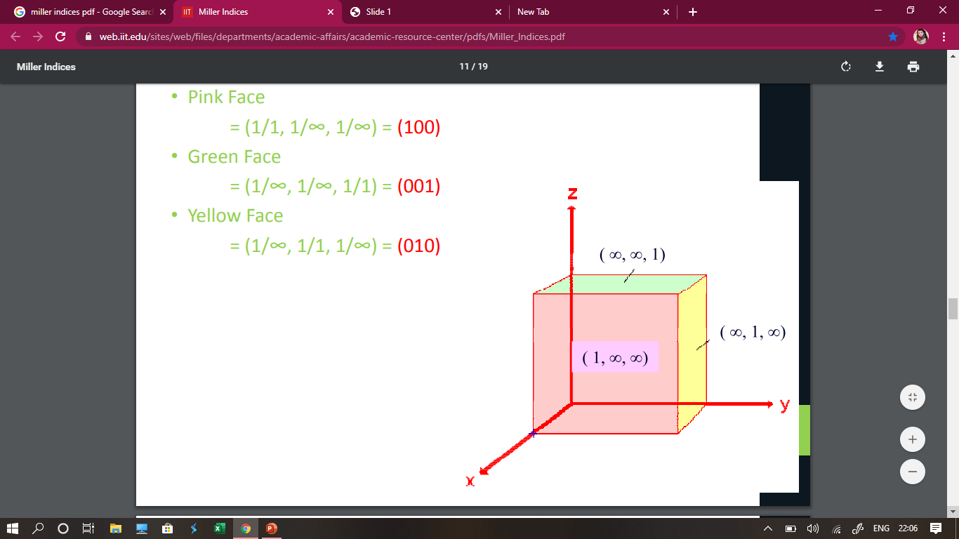
CRYSTAL PLANES-I D
Pink Face
= (1/1, 1/ꚙ, 1/ꚙ)
= (100)
Green face
=(1/ꚙ, 1/ꚙ, 1/1)
=(001)
Yellow face
=(1/ꚙ, 1/1, 1/ꚙ
= (010)
Figure 2.3 one Dimensional planes [3]

Slide 10
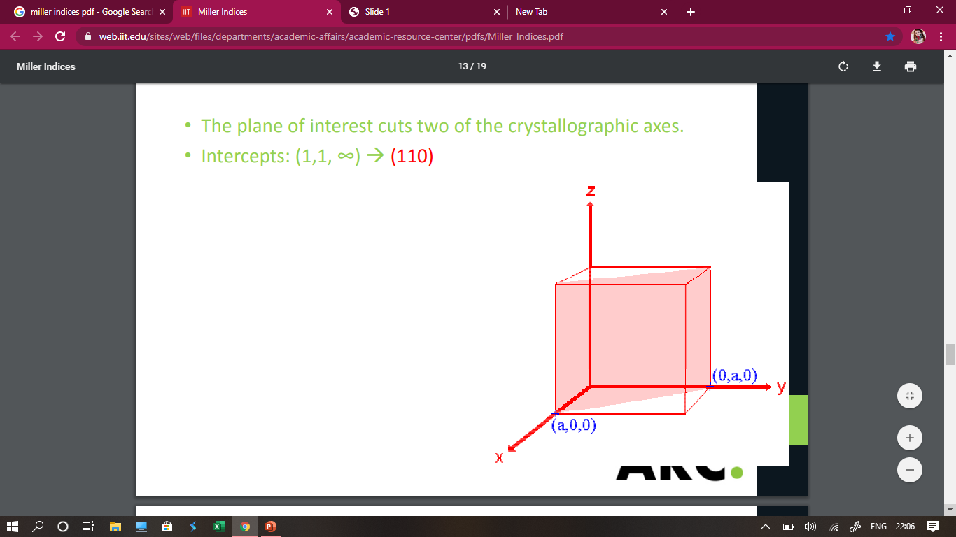
CRYSTAL PLANES- 2D
The plane of interest cuts two of the crystallographic axes
Intercepts (1,1,ꚙ)= (110)
Figure 2.4 two Dimensional planes [3]

Slide 11
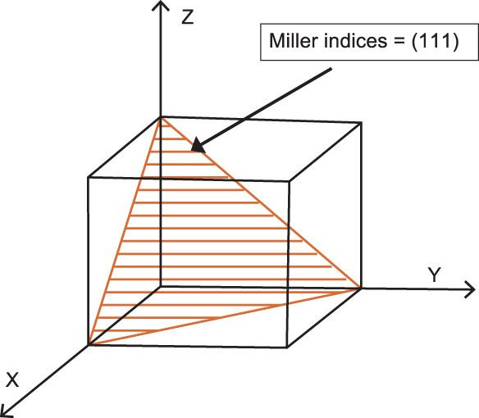
CRYSTAL PLANES- 3D
Figure 2.5 three Dimensional planes [4]

Slide 12
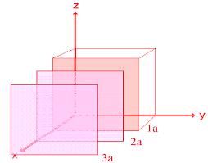
FAMILY OF PLANES-Notation
Notation Summary
(h,k,l) represents a point – note the exclusive use of commas
Negative numbers/directions are denoted with a bar on top of the number
(hkl) represents a plane
{hkl} represents a family of planes
Figure 2.6 family of planes one Dimensional planes [3]

Slide 13
Miller indices
If a Miller index is zero, the plane is parallel to that axis.
Parallel planes have same Miller Indices
If a plane is passing through origin , Miller indices are determined for another plane parallel to this one, both will have same Miller Indices
Multiplying or dividing a Miller index by a constant has no effect on the orientation of the plane.

Slide 14
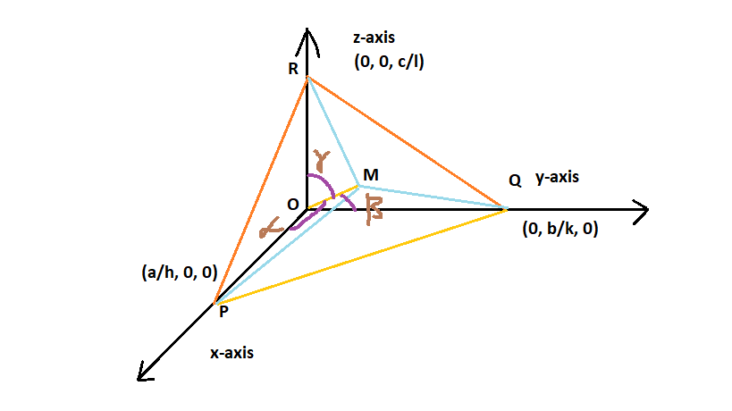
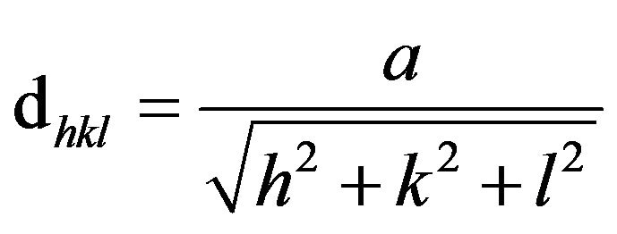
D-SPACING
Figure 2.7 distance between planes [self-made]

Slide 15
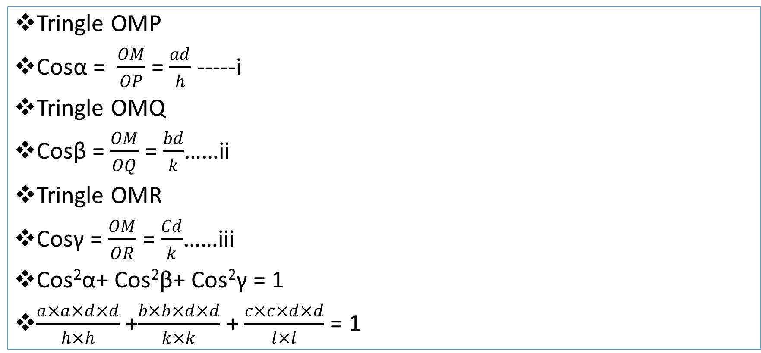
D-SPACING
Tringle OMP
Cosα = $\frac{OM}{OP}$ = $\frac{ad}{h}$ -----i
Tringle OMQ
Cosβ = $\frac{OM}{OQ}$ = $\frac{bd}{k}$……ii
Tringle OMR
Cosγ = $\frac{OM}{OR}$ = $\frac{Cd}{k}$……iii
Cos²α+ Cos²β+ Cos²γ = 1
$\frac{a×a×d×d}{h×h}$ +$\frac{b×b×d×d}{k×k}$ + $\frac{c×c×d×d}{l×l}$ = 1

Slide 16

ATOMIC PACKING FACTOR
It can be defined as the ratio between the volume of the basic atoms of the unit cell (which represent the volume of all atoms in one-unit cell) to the volume of the unit cell itself.

Slide 17
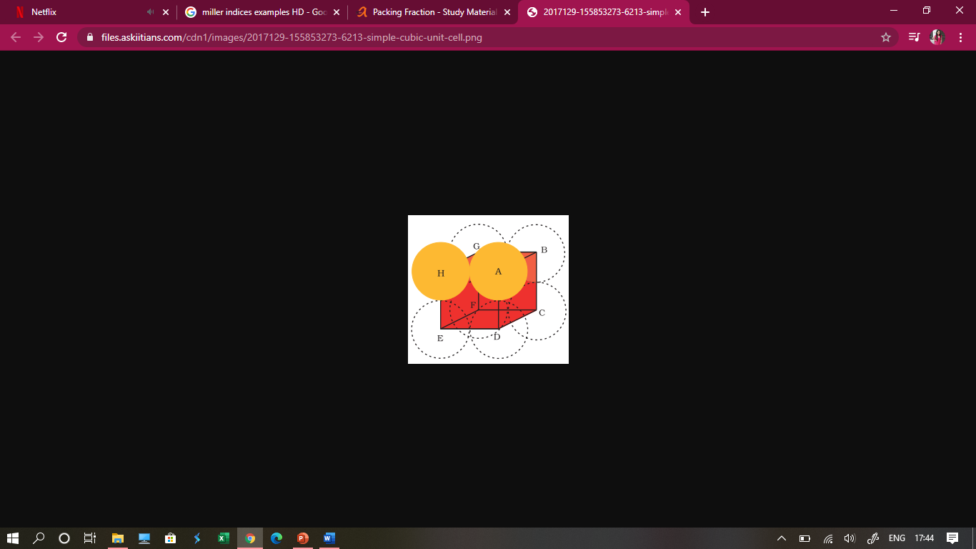
ATOMIC PACKING FACTOR FOR SIMPLE CUBIC
Let ‘a’ be the edge length of the unit cell and r be the radius of sphere.
As sphere are touching each other
Therefore a = 2r
No. of spheres per unit cell = 1/8 × 8 = 1
Volume of the sphere = 4/3 πr³
Volume of the cube = a³= (2r)³ = 8r³
∴ Fraction of the space occupied = 4/3πr³ / 8r³ = 0.524
∴ % occupied = 52.4 %
Figure 2.8 simple cubic unit cell [5]

Slide 18
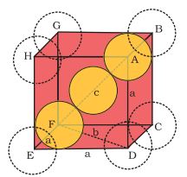
ATOMIC PACKING FACTOR FOR BCC
In body centred cubic unit cell
in tringle EFD
Let DF= b
and we know that
ED=EF= a (edge length)
Now,
b² = a² + a² = 2a²
In Triangle AFD
Let, AF = c
We know that
FD = b
& AD = a (edge length)
Figure 2.9 body centred cubic unit cell [5]

Slide 19
ATOMIC PACKING FACTOR FOR BCC
Now,
c² = a² + b² = a² + 2a² = 2a²
or c = √3 a
we know that c is body diagonal. As the sphere at the centre touches the sphere at the corner. Therefore body diagonal c = 4r
i.e. √3 a = 4r
or r = (√3/4)a
or a = 4r / √3
∴ Volume of the unit cell = a³ = (4r / √3)³ = 64r³ / 3√3
No. of spheres in bcc = 2
∴ volume of 2 spheres = 2 × 4/3πr³
APF= 68 PER

Slide 20
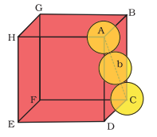
ATOMIC PACKING FACTOR FOR FCC
Let ‘r’ be the radius of sphere and ‘a’ be the edge length of the cube
As there are 4 sphere in fcc unit cell
∴ Volume of four spheres = 4 (4/3 πr³)
In fcc, the corner spheres are in touch with the face centred sphere. Therefore, face diagonal AD is equal to four times the radius of sphere
AC= 4r
But from the right angled triangle ACD
AC = √AD² + DC² = √a² + a²= √2a
4r = √2a
or a = 4/√2 r
∴ volume of cube = (4/√2 r)³
APF= 74
Figure 2.10 face centred cubic unit cell [5]

Slide 21
SUMMARY
Miller indices use for measuring direction in crystal systems.
The miller indices denote as (hkl).
The coordinator of plane parallel to axis is infinity.
The negative of miller indices denote as bar of number.
Interplanar distance can be measured by using miller indices.
Atomic packing determine how closely atoms are packed in unit cell.
The APF for SC, BCC, FCC,HCP is 52 per, 68 per, 74 per respectively.

Slide 22
FREQUENTLY ASKED QUESTIONS
Give example of 1 D, 2D, 3D miller indices and draw them.
Determine miller indices for (3,4,6)
Illustrate concept of calculating miller indices
Derive expression for D- spacing.
Justify the importance of atomic packing fraction
Find the value for APF for BCC.
Justify the importance of miller indices
Illustrate the family of planes {1 1 0}

Slide 23
ASSESSMENT PATTERN
MST(02)
20 marks
Quiz
4 marks
Attendance
(>90%)
2 marks
Surprise test
4 marks
Assignment
10 marks

Slide 24
REFERENCES-BOOKS
Malik H.K, Singh A.K. (2011) Engineering Physics, TMH, New Delhi. ISBN: 9780070671539
T2. Beiser A. (2002) Concepts of Modern Physics, McGraw Hill Education. ISBN: 9780070495531
http://users.encs.concordia.ca/~mmedraj/TMG-Library/books/Crystallography_and_the_World_of_Symmetry.pdf
https://physlab.lums.edu.pk/images/3/35/Symmetry_crystals.pdf

Slide 25
REFERENCES -VIDEOS
https://www.youtube.com/watch?v=8xM3iP1DjG0
https://www.youtube.com/watch?v=iFqRUqwAWvo
https://www.youtube.com/watch?v=kQqc9JXw_7I
https://www.youtube.com/watch?v=xIuuTSJ5Dws
https://www.youtube.com/watch?v=xIuuTSJ5Dws
https://www.youtube.com/watch?v=rZxWyqt3IRE

Slide 26
REFERENCES-WEBSITE
https://nptel.ac.in/content/storage2/courses/112108150/pdf/PPTs/MTS_02_m.pdf
https://www.doitpoms.ac.uk/tlplib/miller_indices/lattice_draw.php
https://uh.edu/~hfang2/MECE3345/Lectures/Chapter3.pdf

Slide 27
IMAGES REFERENCES
[1] https://fortune.com/2020/06/30/america-tech-semiconductor-manufacturing-investment/
[2] https://www.researchgate.net/figure/Miller-indices-of-some-important-planes-in-a-cubic-diamond-crystal_fig13_266740323
[3]https://chem.libretexts.org/Bookshelves/Physical_and_Theoretical_Chemistry_Textbook_Maps/Book%3A_Surface_Science_(Nix)/01%3A_Structure_of_Solid_Surfaces/1.02%3A_Miller_Indices_(hkl)
[4] https://www.spiedigitallibrary.org/ebooks/FG/Field-Guide-to-Crystal-Growth/Miller-Indices/Miller-Indices/10.1117/3.2309590.ch10?SSO=1&tab=ArticleLinkFigureTable
[5] https://www.askiitians.com/iit-jee-solid-state/packing-fraction/

Slide 28
THANK YOU
For queries
Email: subject_code_2019@gmail.com

